Slide 1

ANNUAL REPORT
Activities and Achievements in 2025

Slide 2






EXECUTIVE SUMMARY
DDEA consolidated its organisation and entered a new phase of strategic development, while maintaining a high level of activity across education, networking, and grant funding
Early-career Researchers remained central to DDEA’s activities and governance, contributing to programme development and participating actively across courses, networking activities, and organisational structures
DDEA delivered a comprehensive programme of Educational and Networking Activities across diabetes and classical endocrinology, engaging participants from universities, university hospitals, and industry in Denmark and internationally
The Grant Programme continued to support early-career researchers across a broad range of research areas, from basic science to clinical and translational research
Together with the Danish Cardiovascular Academy, DDEA was invited to prepare an application for a new initiative aimed at strengthening the cardiometabolic value chain through closer integration of the two academies, with a particular focus on the post-PhD level

Slide 3
STRATEGY & GOVERNANCE
DDEA aims to strengthen early-career research capacity through education, networking, and funding across diabetes and classical endocrinology.
”
In 2025, DDEA consolidated its governance structure and entered a new phase of organisational renewal and strategic development.
Three new members joined the Board of Directors at the beginning of 2025, ensuring continuity while introducing new perspectives
The Committee for Education was reconstituted in 2025 with a combination of new and continuing members, supporting continuity in ongoing activities and capacity for future planning
In 2025, DDEA secured external funding from the Ministry of Higher Education and Science to support activities within under-resourced research areas, including type 1 diabetes in low- and middle-income countries
DDEA completed a Self-Evaluation Report assessing its activities, outcomes, and organisational development from 2023–2025

Slide 4


STRATEGY & GOVERNANCE
DDEA, together with the Danish Cardiovascular Academy, was invited to prepare an application for a partly renewed initiative aimed at strengthening the cardiometabolic research value chain, with submission scheduled for 2026.
The proposed initiative focuses on closer integration between the DDEA and DCA communities within a joint cardiometabolic framework, including coordinated career development, networking activities for early-career researchers, and alignment with other national initiatives.

Slide 5
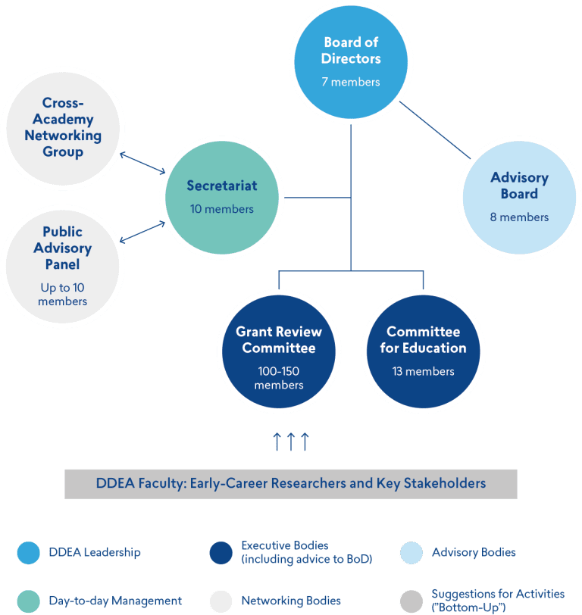
ORGANISATION
The Board of Directors is responsible for defining and determining the overarching strategy of DDEA
The Committee for Education is developing an annual program encompassing DDEA's educational initiatives, talent development, and fostering networking and collaborative efforts
The Grant Review Committee conducts professional peer review assessments of applications for PhD scholarships, postdoctoral fellowships, and visiting researchers
The Advisory Board is charged with critically evaluating DDEA's strategic approach across its four key activity areas, offering feedback, and advising the Board of Directors on potential revisions
The Secretariat is entrusted with implementing DDEA's strategies and activities
The Public Advisory Board, consists of nine individuals with diverse lived experiences endocrine diseases, provide recommendations, ideas, and feedback to the DDEA Secretariat
The Cross Academy Networking Group fosters collaboration between the three NNF-funded academies; DDEA, DDSA, and DCA

Slide 6


SUCCESS CRITERIA
In 2025, DDEA delivered on its core objectives across Education, Networking, and Grant Activities, with performance broadly aligned with the defined success criteria
Selected Success Criteria | Status
Planned number of education and talent development activities delivered | Achieved
Proportion of disease-specific education activities in classical endocrinology | Achieved
Participants reporting acquisition of new skills and competencies | Achieved
Annual number of networking and collaboration activities | Achieved
Engagement with NGOs | Achieved
Activities co-organised with DCA/DDSA, industry, or international institutions | Achieved
Distribution of grants across diabetes and classical endocrinology | Not achieved
Grant-related long-term KPIs | Too early to assess

Slide 7
MAJOR ACCOMPLISHMENTS IN 2025
Consolidation of an Integrated Endocrine Research Environment
In 2025, DDEA continued to strengthen integration across diabetes and classical endocrinology through targeted educational activities and shared programming. This was reflected in the activity portfolio, where a consistent proportion of activities and participants represented classical endocrinology, in line with programme objectives.
Strengthening Patient and Public Involvement (PPI)
In 2025, DDEA further strengthened PPI as a strategic priority. This was reflected in the dedicated PhD course on PPI, which equipped early-career researchers with methods for involving patients and citizens in research, and in revised grant application requirements, where applicants were asked to describe how their projects relate to PPI. DDEA also expanded public engagement through by including citizens and individuals with lived experience as speakers in selected courses and events, helping bring patient perspectives more directly into research discussions.
Integration of Early-Career Researchers in DDEA Activities and Governance
In 2025, early-career researchers remained central to DDEA’s activities and governance. This was reflected in the participation of early-career researchers across activities reaching approximately 50% as well as their contribution to the organisation of courses, workshops, and networking events. In addition, early-career researchers were represented in both the Committee for Education and the Board of Directors and key activities such as the Postdoc Summit were continuously driven by early-career researchers.

Slide 8
BUDGET AND ACCOUNTS
Amounts are stated in 1,000 DKK | Budget | Result | Difference
Educational Activities and Talent Development | 3,700 | 2,999 | 701
Networking and Collaboration Activities | 1,500 | 1,254 | 245
Grants | 38,475 | 34,084 | 4,390
Secretariat (salary) | 4,719 | 4,825 | -86
Running costs | 2,145 | 1,576 | 608
Host institutions' direct costs associated with DDEA | 846 | 838 | 6
Total | 51,386 | 45,538 | 5,868

Slide 9


EDUCATIONAL AND NETWORKING ACTIVITIES
6
PhD
COURSES
5
POSTDOCTORAL
COURSES
4
SYMPOSIA
20
NETWORKING
ACTIVITIES
JANUARY
JULY
APRIL
OCTOBER

Slide 10





EDUCATIONAL AND NETWORKING ACTIVITIES
4.6 / 5
SATISFACTION SCORE
DDEA continued to engage broadly across sectors.
Participants represented universities, hospitals, and industry. Activities were carried out in collaboration with national and international partners, including joint activities with other academies, industry partners, and non-governmental organisations.

Slide 11
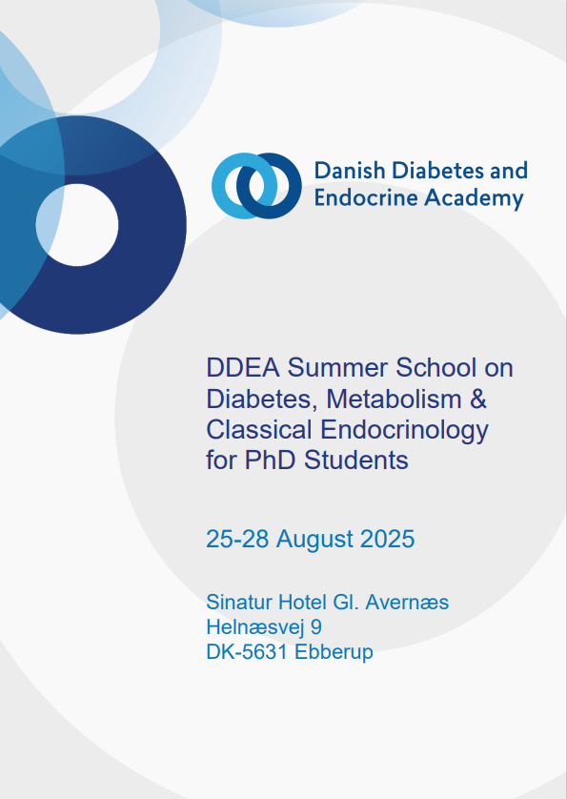
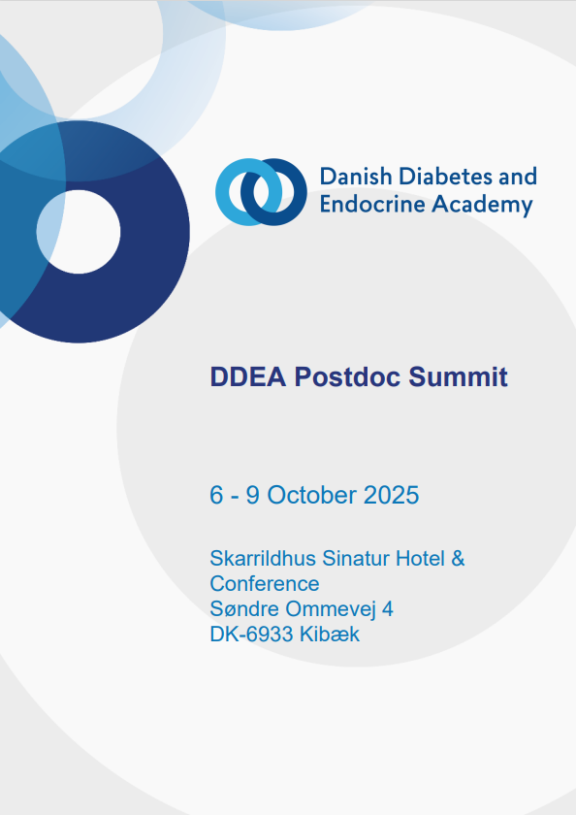
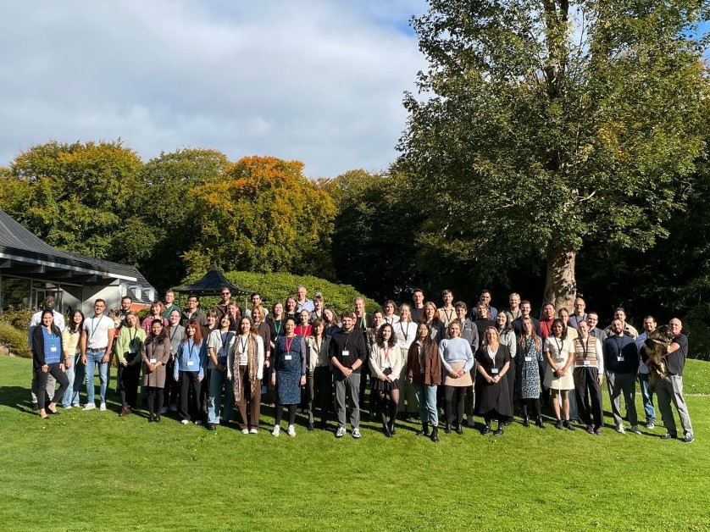
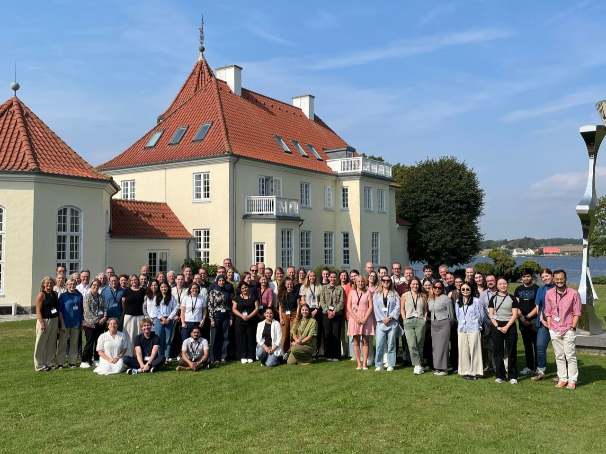
FLAGSHIP ACTIVITIES

Slide 12
GRANT ACTIVITIES
In 2025, DDEA awarded 39 grants across nine programmes, supporting research capacity across diabetes, metabolism, and classical endocrinology, with a focus on early-career researchers and interdisciplinary collaboration.
The 2025 portfolio covered a broad range of research areas from basic molecular mechanisms to clinical and translational studies. Funded projects addressed topics such as insulin resistance, diabetic complications, obesity, reproductive health, and endocrine tumour syndromes, reflecting the diversity of the endocrine research field.
DDEA continued to prioritise collaboration across sectors and institutions. Several grants were awarded in collaboration with international partners, including institutions in Europe, the United States, Asia, and Australia, supporting joint research projects and knowledge exchange.
17 PhD Scholarships awarded
7 Visiting Researcher Grants awarded
15 Postdoctoral Fellowships awarded

Slide 13



COMMUNICATIONS
DDEA website
www.ddeacademy.dk
7,920 followers
23.4% increase in followers*
1,200 followers
18.0% increase in followers*
* Compared to 2024

Slide 14

FUTURE FOCUS
2026 will be a pivotal year for DDEA and marks the beginning of the final phase of the current funding period, which concludes at the end of 2027.
Key priorities include maintaining the quality and volume of educational and networking activities, awarding the remaining grants foreseen in the programme, ensuring proper follow-up on ongoing grants, and fulfilling reporting and administrative obligations.
In parallel, DDEA is contributing its experience and expertise to the development of a new cardiometabolic initiative, being prepared together with the Danish Cardiovascular Academy and planned for launch after the current DDEA funding period.

